Slide 1

Apache Airflow

Slide 2
Agenda
What is airflow?
Airflow Architecture
Airflow concepts
Airflow UI explanation
Installation
Practice Codes

Slide 3
What is Airflow ?
Apache Airflow is open source platform to programmatically author ,schedule and monitor workflows.
Benefits:
Data pipelines will be dynamic
Scalability
Good UI
Inbuilt retry mechanism

Slide 4
Airflow Architecture
Core Components:
Webserver : Flask server with Gunicorn serving the UI
Scheduler : Daemon in charge of scheduling flows
Metastore (backend) :Airflow uses a SQL database to store metadata about the data pipelines being run
Executor : Defines how your tasks(work) should run
Worker : Runs your task

Slide 5
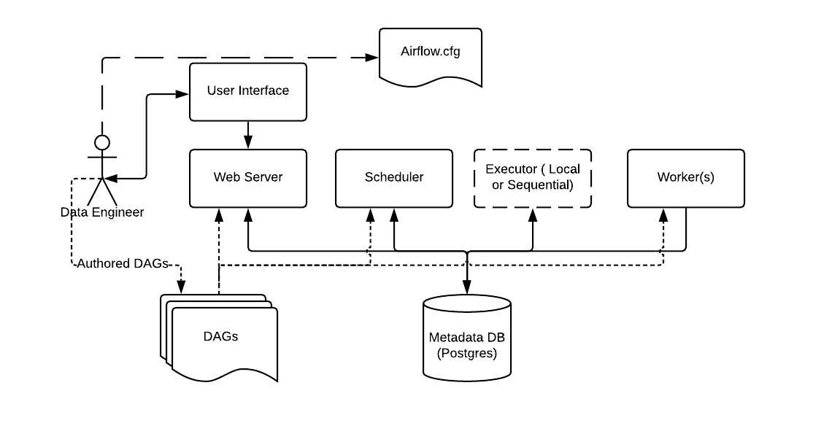
Airflow Architecture

Slide 6
Airflow Concepts:
Below are the core concepts
DAG
Operator
Workflow

Slide 7
Airflow Concepts: DAG
A DAG ( Directed Acyclic Graph ) is a finite directed graph that doesn’t have any cycles ( loops ).
A cycle is a series of vertices that connect back to each other making a loop.
In Apache Airflow, a DAG represents a collection of tasks to run, organized in a way that represent their dependencies and relationships.
Its job is to make sure that tasks happen at the right time in the right order with the right handling of any unexpected issues.
It ultimately defines our Workflow.
Each node is a Task.
Each edge is a Dependency

Slide 8
Airflow Concepts: DAG
DAG is defined in a Python script, which represents the DAGs structure (tasks and their dependencies) as code
DAGs are defined in standard Python files that are placed in Airflow’s DAG_FOLDER
For example, a simple DAG could consist of three tasks: A, B, and C. It could say that A has to run successfully before B can run, but C can run anytime

Slide 9
Core Components: Operator
While DAGs describe how to run a workflow, Operators determine what actually gets done by a task.
An operator describes a single task in a workflow.
Operators are usually (but not always) atomic, meaning they can stand on their own and don’t need to share resources with any other operators

Slide 10
Airflow Concepts: Types of operators
There are three main types of operators
Action operators: Allows Executing functions/commands
Ex: bashoperator : allows you to execute bash commands
Transfer operators: Allows data to transfer b/w source and destination
Ex :S3ToRedshiftOperator: copies data from a S3 Bucket into a Redshift table
Sensors : Sensors are special types of operators whose purpose is to wait on some external or internal trigger . They wait something to happen before moving to next task
Ex : S3KeySensor: S3 Key sensors are used to wait for a specific file or directory to be available on an S3 bucket.

Slide 11
Airflow Concepts: Tasks
Task : Any instance of the operator is referred to as a task.
Here’s an example of an operator being used to create a task.
task_1 =BashOperator(task_id='test_task',bash_command='echo Helloo',dag=dag,)
The above example is a bash operator, which takes a bash command as an argument. When the task executes, it runs the commands and the output can be found in the logs

Slide 12
Airflow Concepts: Tasks Linking
There are multiple ways to link tasks in a DAG to each other
Set Upstream and Downstream:
Lets say we have two tasks t1 and t2 then we can set dependencies as
t1.set_downstream(t2) # This means t2 will depend t1 which is also equivalent to
t2.set_upstream(t1)
Bit shift Composition :
task1 >> task2# the above is the same as task1.set_downstream(task2)
task2 << task1 # which is the same as task1.set_upstream(task2)
# we can also chain these operators# the line below chains task 2 after task 1 and task3 after 2, also task 4 is to be executed before task 3
task1 >> task2 >> task3 << task4

Slide 13
Airflow Concepts: Tasks instance
Task Instance is a run of the task
Each DAG run consists of multiple tasks and every run of these tasks is referred to as task instances
A task instance goes through multiple states when running and a complete lifecycle can be easily found on the Airflow UI
The happy flow consists of the following stages:
No status (scheduler created empty task instance)
Scheduled (scheduler determined task instance needs to run)
Queued (scheduler sent the task to the queue – to be run)
Running (worker picked up a task and is now executing it)
Success (task completed)

